Slide 1


Team Kappa
Introducing:
Acumatica Genie

Slide 2
We have a lot of responses to our marketing campaigns but not enough staff to handle it

Slide 3
Do we hire more people to handle the workload? Not anymore!

Slide 4
Introducing Acumatica Genie! Your one stop solution for lead generation within Acumatica

Slide 5
Acumatica Genie is an AI-powered real-time text-message service to generate and log your leads... straight to Acumatica

Slide 6
You can maintain a continuous conversation with your leads, with all data sent back to the lead record in Acumatica

Slide 7
Acumatica Genie is built on the extensible Pipedream platform, to plug in a variety of different services over time

Slide 8
Lets Give It A Try! Please take our your phone and text us First Name Last Name and Question at:
206-580-4523

Slide 9
How does Acumatica Genie work?

Slide 10
Service Architecture
Acumatica Custom Webhook
Pipedream API Platform
Telnyx Text Messaging API
OpenAI ChatGPT

Slide 11
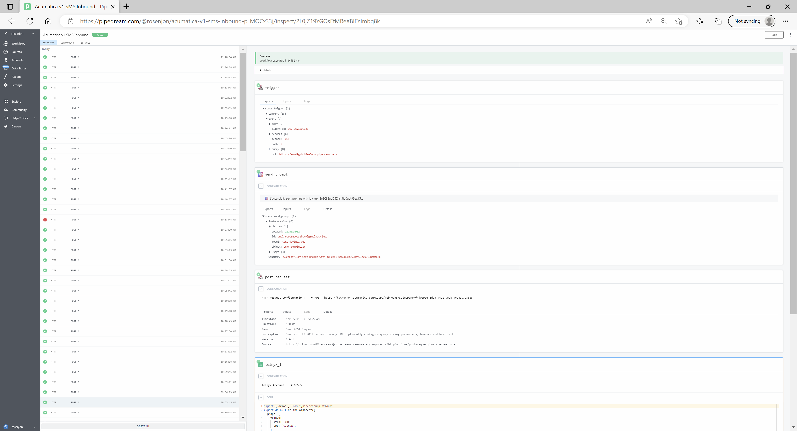
Workflow organized into modular steps…either pre-built, or pure code
Complete request history

Slide 12
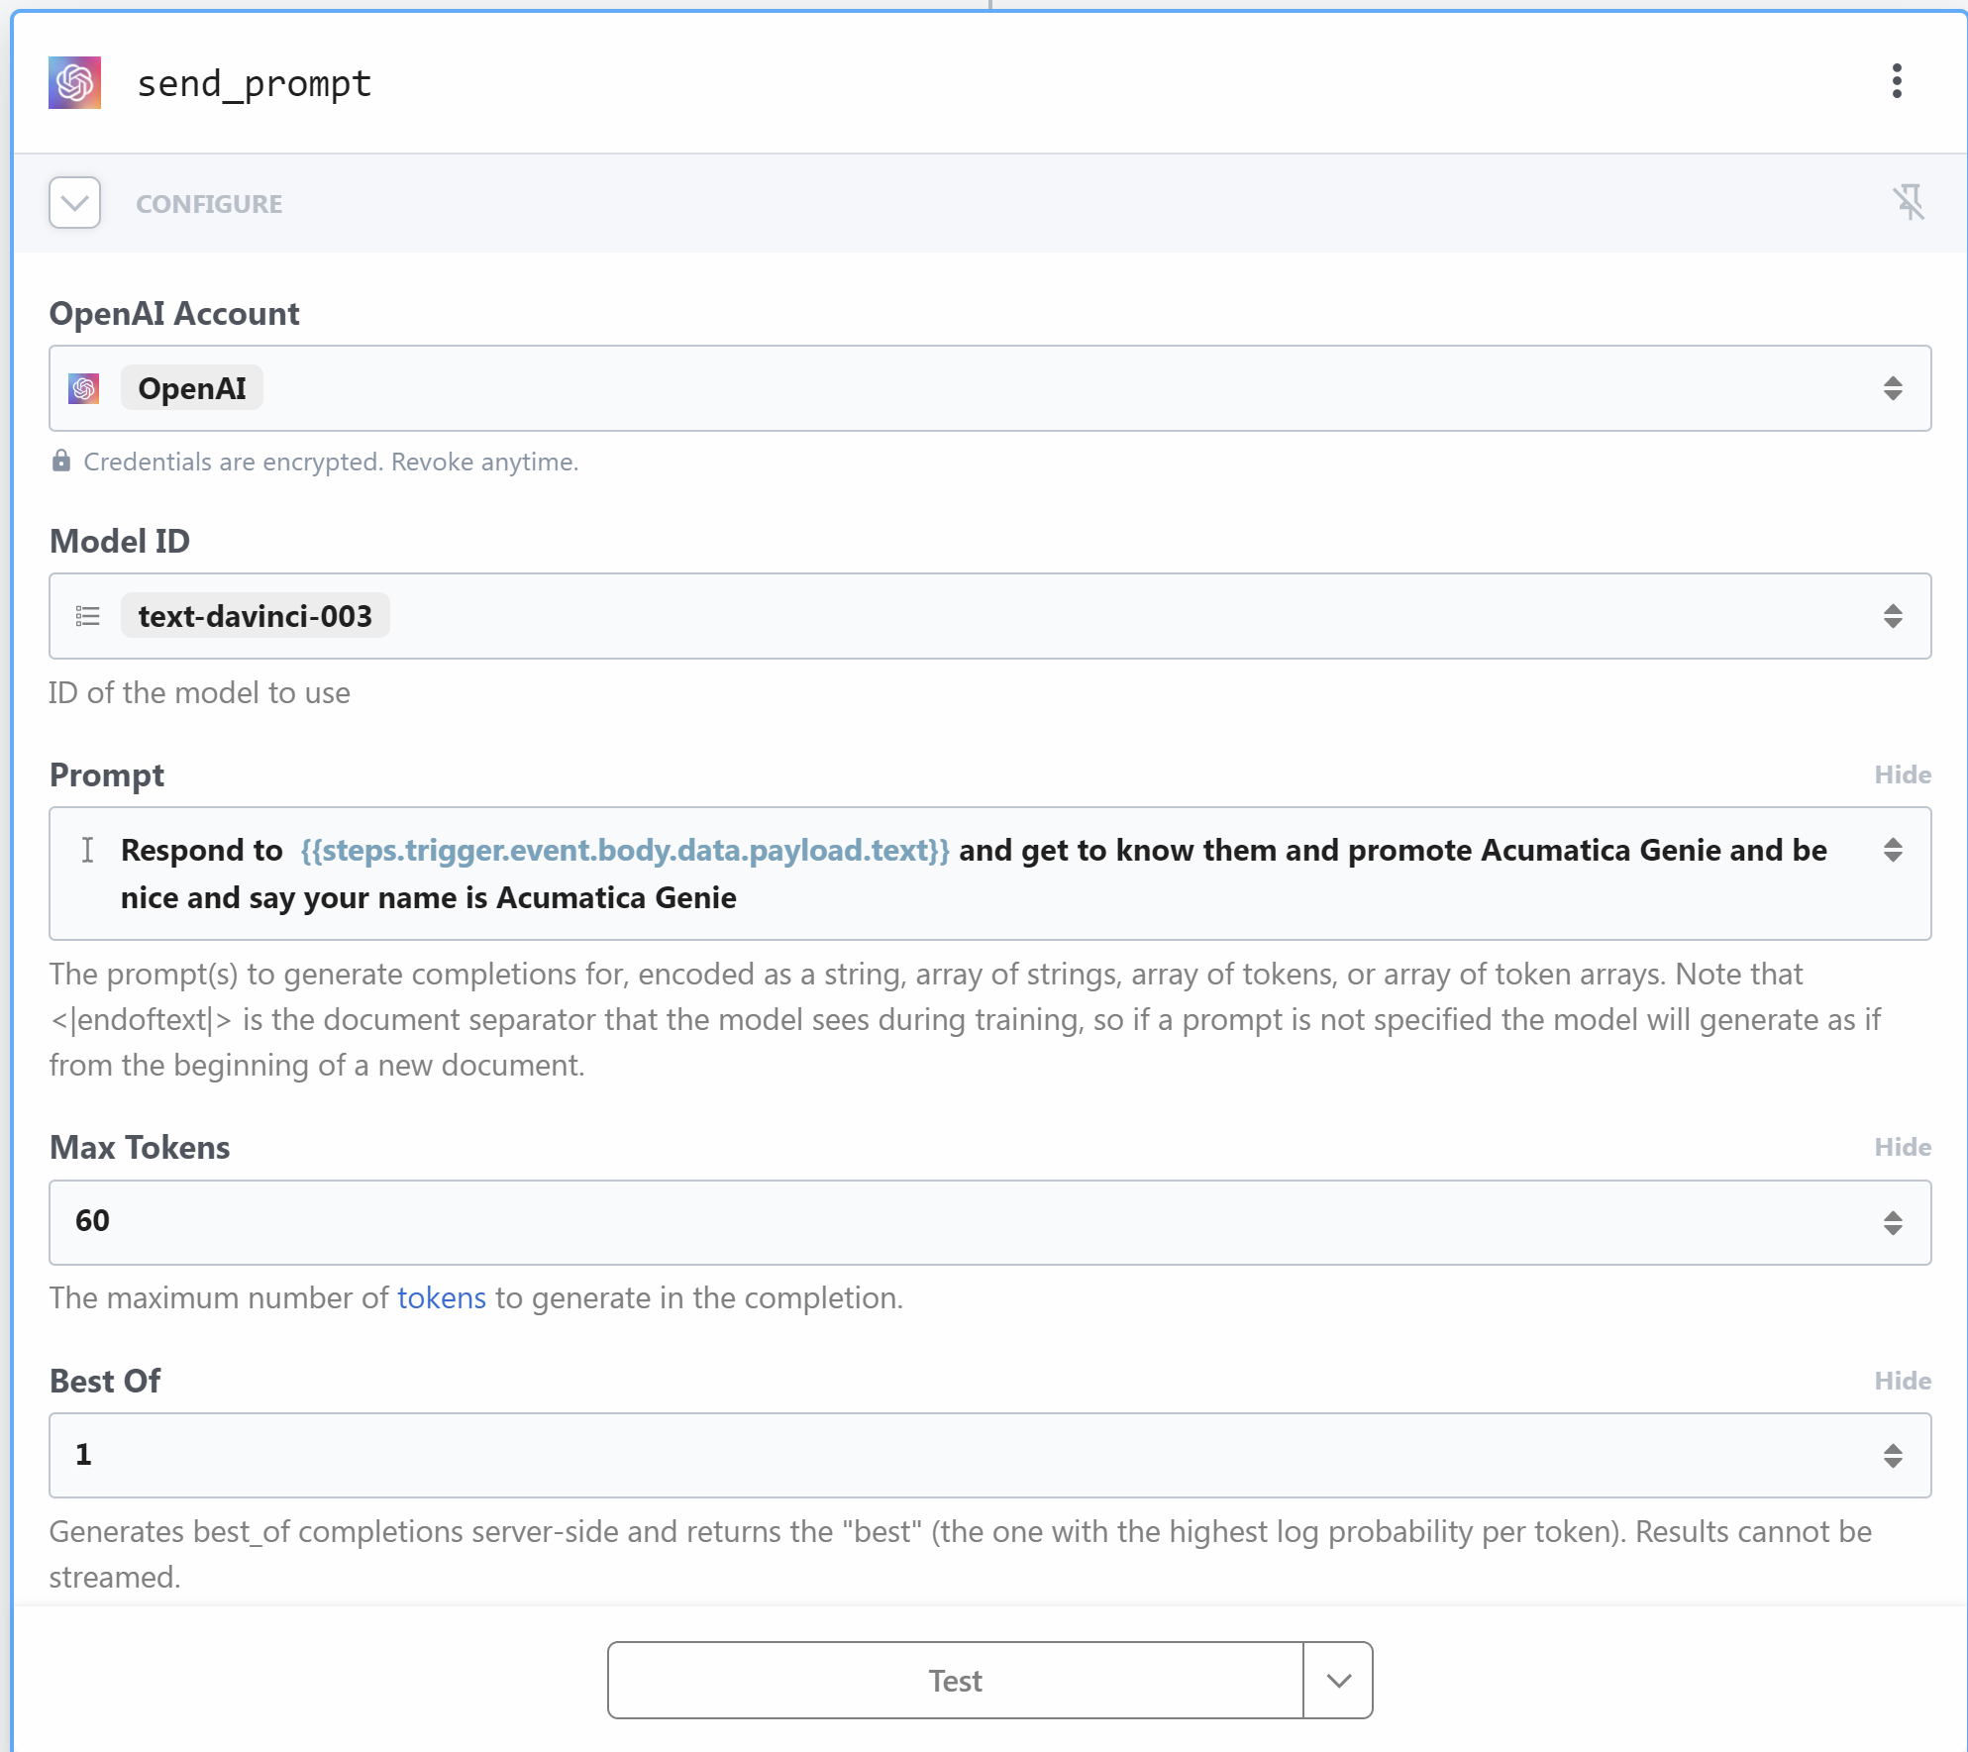
Example Pipedream Step… out-of-the-box integration with OpenAI sent_prompt endpoint

Slide 13
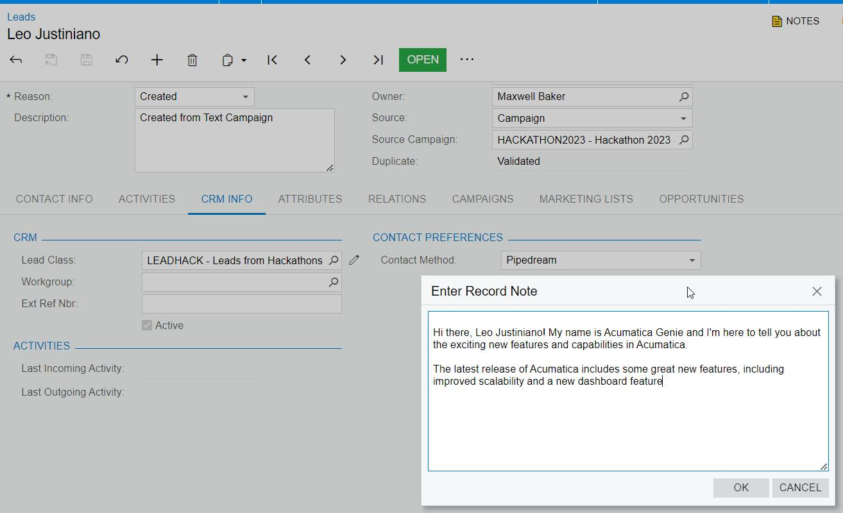

Slide 14
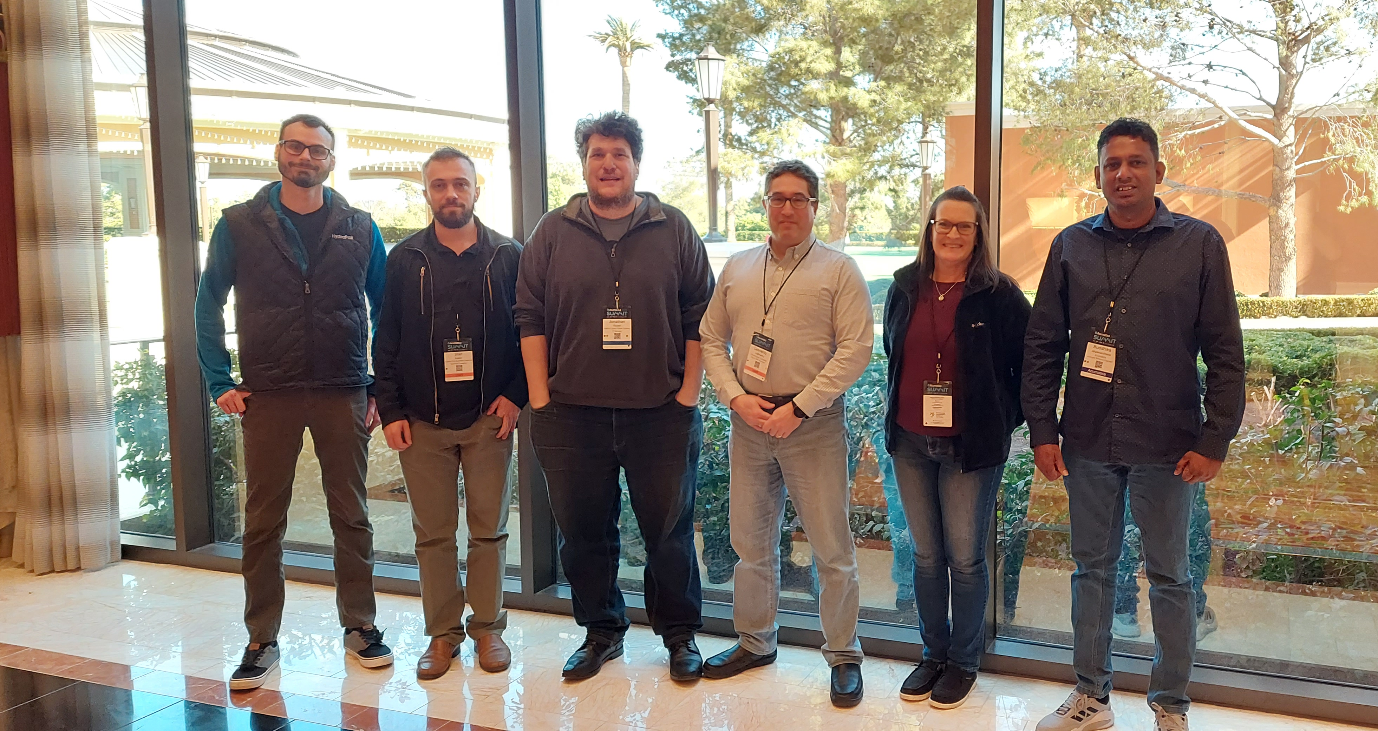
Say goodbye to the old manual way of handling leads, and say hello to Acumatica Genie!

